Slide 1
Chapter 5: Advanced SQL
Notes:
从高级程序设计语言（如C语言）访问关系数据库主要有API和嵌入式SQL两种方式。SQL和高级程序设计语言存在着基本数据类型和执行方式两方面的不匹配，嵌入式SQL通过游标(cursor)等方式处理这些不匹配的问题

Slide 2
Accessing SQL from a Programming Language
A database programmer must have access to a general-purpose programming language for at least two reasons
Not all queries can be expressed in SQL, since SQL does not provide the full expressive power of a general-purpose language.
Non-declarative actions -- such as printing a report, interacting with a user, or sending the results of a query to a graphical user interface -- cannot be done from within SQL.

Slide 3
Accessing SQL from a Programming Language (Cont.)
There are two approaches to accessing database from a general-purpose programming language
API （Application Program Interface） - - A general-purpose program can connect to and communicate with a database server using a collection of functions.
Embedded SQL -- provides a means by which a program can interact with a database server.
  The SQL statements are translated at compile time into function calls.
  At runtime, these function calls connect to the database using an API that provides dynamic SQL facilities.

Slide 4
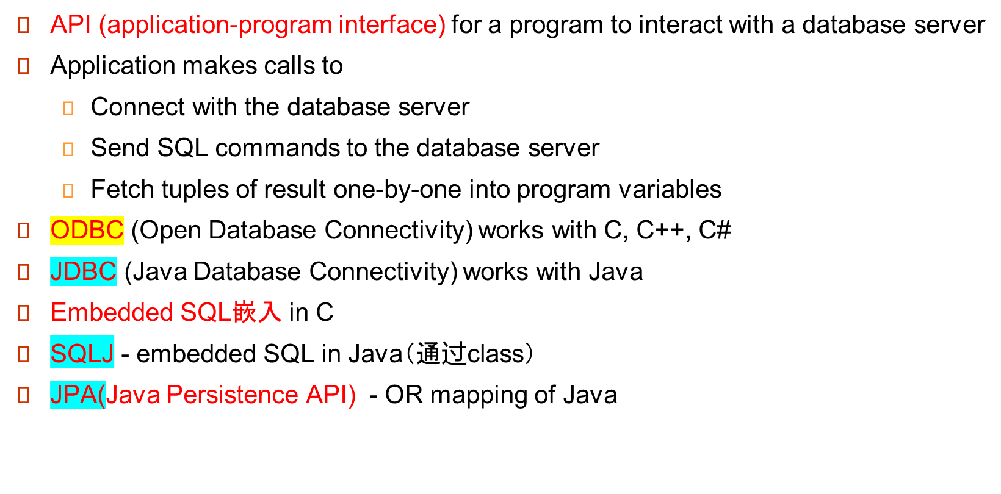
JDBC and ODBC
Notes:
高级语言和SQL的冲突：SQL返回的集合在高级语言中没有对应，基本数据类型不匹配（日期类型这种）
建议多用preparation，执行速度快得多（会被优化）；而不是每次都execute directly，而且这样不安全

Slide 5
JDBC
JDBC is a Java API for communicating with database systems supporting SQL.
JDBC supports a variety of features for querying and updating data, and for retrieving query results.
JDBC also supports metadata retrieval, such as querying about relations present in the database and the names and types of relation attributes.
Model for communicating with the database:
  Open a connection
  Create a “statement” object
  Execute queries using the Statement object to send queries and fetch results
  Exception mechanism to handle errors
Notes:
通过类class来封装

Slide 6
JDBC Code
  public static void JDBCexample(String dbid, String userid, String passwd)
{
  try {
    Connection conn = DriverManager.getConnection(
    "jdbc:oracle:thin:@db.yale.edu:2000:univdb", userid, passwd);
  Statement stmt = conn.createStatement();
  … 具体的工作….
  stmt.close();
  conn.close();
  }
  catch (SQLException sqle) {
  System.out.println("SQLException : " + sqle);
  }
}
取得连接
数据源
Sqle是抛出的异常

Slide 7
JDBC Code (Cont.)
Update to database
try {
stmt.executeUpdate(
"insert into instructor values(’77987’, ’Kim’, ’Physics’, 98000)");
} catch (SQLException sqle)
{
System.out.println("Could not insert tuple. " + sqle);
}
Execute query and fetch and print results
  ResultSet rset = stmt.executeQuery(
  "select dept_name, avg (salary)
  from instructor
  group by dept_name");
  while (rset.next()) {
  System.out.println(rset.getString("dept_name") + " " +
  rset.getFloat(2));
  }
类型对应
Notes:
Query的时候，刚开始指针指向的不是头一个，而且第一个的前面一个

Slide 8
JDBC Code Details
Getting result fields:
  rset.getString(“dept_name”) and rset.getString(1) equivalent if dept_name is the first argument of select result.
Dealing with Null values
  int a = rset.getInt(“a”);
  if (rset.wasNull()) Systems.out.println(“Got null value”);

Slide 9
Prepared Statement
PreparedStatement pStmt = conn.prepareStatement(
"insert into instructor values(?,?,?,?)");
pStmt.setString(1, "88877"); pStmt.setString(2, "Perry");
pStmt.setString(3, "Finance"); pStmt.setInt(4, 125000);
pStmt.executeUpdate();
pStmt.setString(1, "88878");
pStmt.executeUpdate();
WARNING: always use prepared statements when taking an input from the user and adding it to a query
  NEVER create a query by concatenating strings which you get as inputs
  "insert into instructor values(’ " + ID + " ’, ’ " + name + " ’, " +
  " ’ " + dept name + " ’, " + salary + ")"
  What if name is “D’Souza”?
只需要改变参数即可

Slide 10
SQL Injection(SQL 注入攻击)
Suppose query is constructed using
  "select * from instructor where name = ’" + name + “ ’ "
Suppose the user, instead of entering a name, enters:
  X’ or ’Y’ = ’Y
then the resulting string of the statement becomes:
  "select * from instructor where name = ’" + "X’ or ’Y’ = ’Y" + “’"
  which is:
    select * from instructor where name = ’X’ or ’Y’ = ’Y’
  User could have even used
    X’; update instructor set salary = salary + 10000;
    then →
    select * from instructor where name = ’X’;
    update instructor set salary = salary + 10000;
Always use prepared statements, with user inputs as parameters始终使用准备好的语句，将用户输入作为参数
攻击行为

Slide 11
Metadata Features
ResultSet metadata
E.g., after executing query to get a ResultSet rs:
  ResultSetMetaData rsmd = rs.getMetaData();
  for(int i = 1; i <= rsmd.getColumnCount(); i++) {
  System.out.println(rsmd.getColumnName(i));
System.out.println(rsmd.getColumnTypeName(i));
}

Slide 12
Metadata (Cont)
Database metadata类
DatabaseMetaData dbmd = conn.getMetaData();
ResultSet rs = dbmd.getColumns(null, "univdb", "department", "%");
// Arguments to getColumns: Catalog, Schema-pattern, Table-pattern,
// and Column-Pattern
// Returns: One row for each column; row has a number of attributes
// such as COLUMN_NAME, TYPE_NAME
while( rs.next()) {
System.out.println(rs.getString("COLUMN_NAME"),
rs.getString("TYPE_NAME");
}
Notes:
获得数据库的元数据

Slide 13
Transaction Control in JDBC
By default, each SQL statement is treated as a separate transaction that is committed automatically
  bad idea for transactions with multiple updates
Can turn off automatic commit on a connection
  conn.setAutoCommit(false);
Transactions must then be committed or rolled back explicitly
  conn.commit(); or
  conn.rollback();
conn.setAutoCommit(true) turns on automatic commit.

Slide 14
Other JDBC Features
Calling functions and procedures
  CallableStatement cStmt1 = conn.prepareCall("{? = call some function(?)}");
  CallableStatement cStmt2 = conn.prepareCall("{call some procedure(?,?)}");
Handling large object types
  getBlob() and getClob() that are similar to the getString() method, but return objects of type Blob and Clob, respectively
  get data from these objects by getBytes()
  associate an open stream with Java Blob or Clob object to update large objects
    blob.setBlob(int parameterIndex, InputStream inputStream).

Slide 15
SQLJ
JDBC is overly dynamic, errors cannot be caught by compiler
SQLJ: embedded SQL in Java
  #sql iterator deptInfoIter ( String dept name, int avgSal);
  deptInfoIter iter = null;
  #sql iter = { select dept_name, avg(salary) as avgSal from instructor
  group by dept name };
  while (iter.next()) {
  String deptName = iter.dept_name();
  int avgSal = iter.avgSal();
  System.out.println(deptName + " " + avgSal);
  }
  iter.close();
一条嵌入式语句。最后他会自动转换为JDBC的形式
Notes:
了解一下就行

Slide 16
ODBC
Open DataBase Connectivity(ODBC) standard
  standard for application program to communicate with a database server.
  application program interface (API) to
    open a connection with a database,
    send queries and updates,
    get back results.
Applications such as GUI, spreadsheets, etc. can use ODBC
Was defined originally for Basic and C, versions available for many languages.
Notes:
不封装，就是一条条函数语句

Slide 17
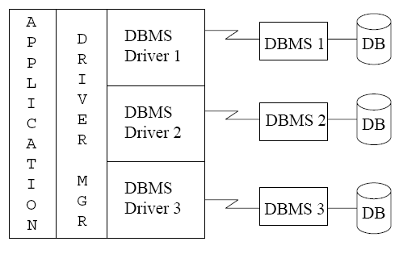
ODBC (Cont.)
Each database system supporting ODBC provides a "driver" library that must be linked with the client program.
Notes:
支持ODBC的每个数据库系统都提供一个“驱动程序”库，必须与客户机程序链接。比较好的适应产品变化的能力

Slide 18
ODBC (Cont.)
Each database system supporting ODBC provides a "driver" library that must be linked with the client program.
When client program makes an ODBC API call, the code in the library communicates with the server to carry out the requested action, and fetch results.
ODBC program first allocates an SQL environment, then a database connection handle.
Opens database connection using SQLConnect(). Parameters for SQLConnect:
  connection handle,
  the server to which to connect
  the user identifier,
  password
Must also specify types of arguments:
  SQL_NTS denotes previous argument is a null-terminated string.

Slide 19
ODBC Code
int ODBCexample()
{
  RETCODE error;
  HENV env; /* environment */
  HDBC conn; /* database connection */
  SQLAllocEnv(&env);
  SQLAllocConnect(env, &conn);
  SQLConnect(conn, “db.yale.edu", SQL_NTS, "avi", SQL_NTS, "avipasswd", SQL_NTS);
  { …. Do actual work … }
  SQLDisconnect(conn);
  SQLFreeConnect(conn);
  SQLFreeEnv(env);
}
获得一个运行环境
获得一个对象
以’\0’结束（C的要求）

Slide 20
ODBC Code
Program sends SQL commands to database by using SQLExecDirect 直接运行
Result tuples are fetched using SQLFetch()
SQLBindCol() binds C language variables to attributes of the query result 把SQLFetch回的东西和c里面的某个东西关联
  当获取一个元组时，它的属性值自动存储在相应的C变量中
  Arguments to SQLBindCol()
    ODBC stmt variable, attribute position in query result
    The type conversion from SQL to C.
    The address of the variable.
    For variable-length types like character arrays,
      The maximum length of the variable
      Location to store actual length when a tuple is fetched.
      Note: A negative value returned for the length field indicates null value
Good programming requires checking results of every function call for errors; we have omitted most checks for brevity.

Slide 21
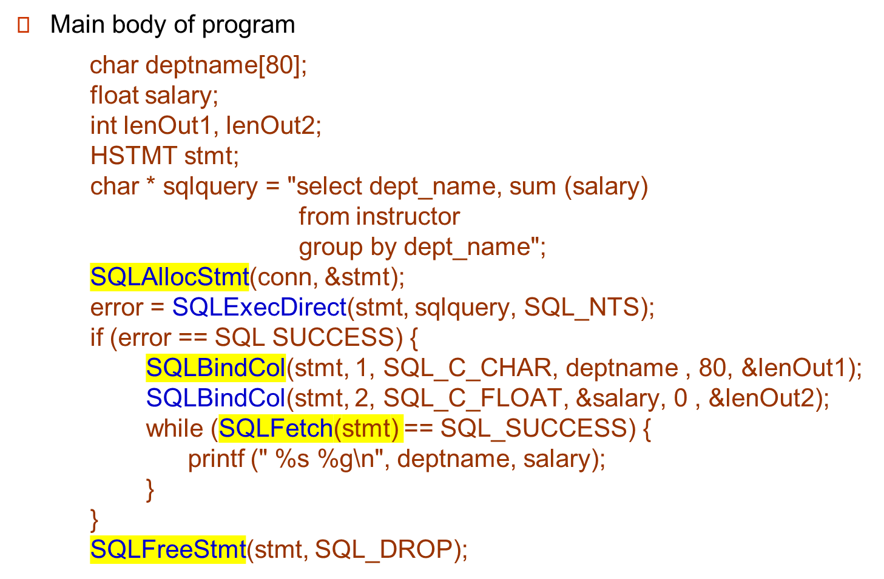
ODBC Code
SQL的varchar长度+1结束符
实际长度
Notes:
这里也是直接执行的，可能会被SQL注入攻击

Slide 22
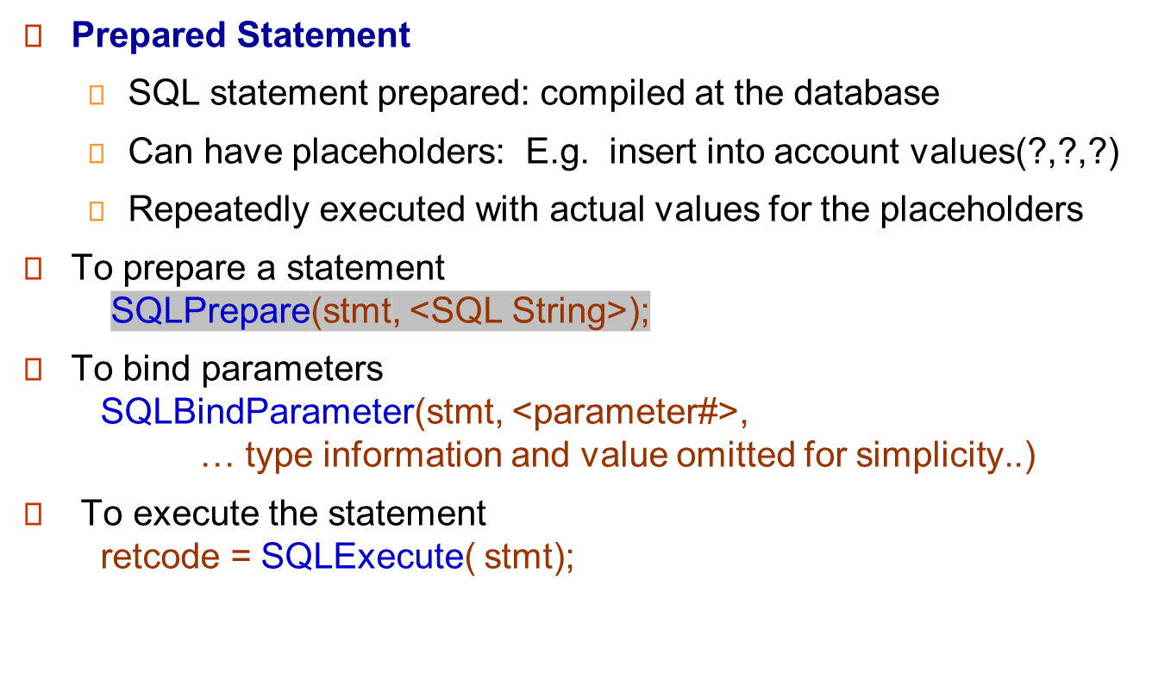
ODBC Prepared Statements
模板，，可以带占位符
绑定参数

Slide 23
SQL injection（SQL注入）
An SQL injection example in Java:
“select * from instructor where name= ’ ” + name + ” ’ ”
malicious hacker enters name : X’ or ’Y’ =’Y
→
select * from instructor where name= ’ X’ or ’Y’ =’Y ’
In the resulting SQL statement, the where clause is always true and the entire instructor relation is returned.
Use of prepared statement would prevent this problem because the input string would have escape characters(转义符) inserted, so the resulting query becomes:
select * from instructor where name= ’ X\’ or \ ’Y\’ =\’Y ’
This query is harmless and returns the empty relation.
To avoid SQL injection security risk, do not create SQL strings directly using user input; instead use prepared statements to bind user inputs.

Slide 24
More ODBC Features
Metadata features
  finding all the relations in the database and
  finding the names and types of columns of a query result or a relation in the database.
By default, each SQL statement is treated as a separate transaction that is committed automatically.
  Can turn off automatic commit on a connection
    SQLSetConnectOption(conn, SQL_AUTOCOMMIT, 0)}
  Transactions 事务 must then be committed or rolled back explicitly by
    SQLTransact(conn, SQL_COMMIT) or
    SQLTransact(conn, SQL_ROLLBACK)

Slide 25
Embedded SQL 嵌入SQL
The SQL standard defines embeddings of SQL in a variety of programming languages such as C, C++, Java, Fortran, and PL/1,
A language to which SQL queries are embedded is referred to as a host language, and the SQL structures permitted in the host language comprise embedded SQL.
The basic form of these languages follows that of the System R embedding of SQL into PL/1.
EXEC SQL statement is used in the host language to identify embedded SQL request to the preprocessor
EXEC SQL <embedded SQL statement >;
Note标记: this varies by language:
  In some languages, like COBOL, the semicolon is replaced with END-EXEC
  In Java embedding uses # SQL { …. };
Notes:
需要在C编译前，预编译
看上去直观，但是debug有点麻烦。编译前检查

Slide 26
Embedded SQL (Cont.)
Before executing any SQL statements, the program must first connect to the database. This is done using:
EXEC-SQL connect to server user user-name using password;
Here, server identifies the server to which a connection is to be established.
Variables of the host language can be used within embedded SQL statements. They are preceded by a colon (:) to distinguish from SQL variables (e.g., :credit_amount )
Host Variables used as above must be declared within DECLARE section, as illustrated below. The syntax for declaring the variables, however, follows the usual host language syntax.
EXEC-SQL BEGIN DECLARE SECTION
int credit-amount ;
EXEC-SQL END DECLARE SECTION;

Slide 27
Embedded SQL (Cont.)
To write an embedded SQL query, we use the
declare c cursor for <SQL query>
statement. The variable c is used to identify the query
Example:
  From within a host language, find the ID and name of students who have completed more than the number of credits stored in variable credit_amount in the host langue
  Specify the query in SQL as follows:
  EXEC SQL
  declare c cursor for
  select ID, name
  from student
  where tot_cred > :credit_amount;

Slide 28
Embedded SQL (Cont.)
The open statement for our example is as follows:
EXEC SQL open c ;
This statement causes the database system to execute the query and to save the results within a temporary relation. The query uses the value of the host-language variable credit-amount at the time the open statement is executed.
The fetch statement causes the values of one tuple in the query result to be placed on host language variables.
EXEC SQL fetch c into :si, :sn；
Repeated calls to fetch get successive tuples in the query result

Slide 29
Embedded SQL (Cont.)
A variable called SQLSTATE in the SQL communication area (SQLCA) gets set to '02000' to indicate no more data is available
The close statement causes the database system to delete the temporary relation that holds the result of the query.
EXEC SQL close c ;

Slide 30
Updates Through Embedded SQL
Embedded SQL expressions for database modification (update, insert, and delete)
Can update tuples fetched by cursor by declaring that the cursor is for update
EXEC SQL
declare c cursor for
select *
from instructor
where dept_name = 'Music'
for update
We then iterate through the tuples by performing fetch operations on the cursor , and after fetching each tuple we execute the following code:
update instructor
set salary = salary + 1000
where current of c

Slide 31
Procedural Constructs in SQL
SQL中的过程结构

Slide 32
Procedural Extensions and Stored Procedures
SQL provides a module language
  Permits definition of procedures in SQL, with if-then-else statements, for and while loops, etc.
Stored Procedures
  Can store procedures in the database
  then execute them using the call调用 statement
  permit external applications to operate on the database without knowing about internal details
Notes:
模块化，方便调用
预编译，提高效率
减少使用高级语言，减少程序间交互，提高速度

Slide 33
Functions and Procedures
Functions and procedures allow “business logic” to be stored in the database and executed from SQL statements.
These can be defined either by the procedural component of SQL or by an external programming language such as Java, C, or C++.
The syntax we present here is defined by the SQL standard.
  Most databases implement nonstandard versions of this syntax.

Slide 34
SQL Functions
Define a function that, given the name of a department, returns the count of the number of instructors in that department.
create function dept_count (dept_name varchar(20))
returns integer
begin
declare d_count integer;
select count (* ) into d_count
from instructor
where instructor.dept_name = dept_name
return d_count;
end
Find the department name and budget of all departments with more that 12 instructors.
select dept_name, budget
from department
where dept_count (dept_name ) > 1

Slide 35
Table Functions
SQL:2003 added functions that return a relation as a result
Example: Return all accounts owned by a given customer
create function instructors_of (dept_name char(20) )
returns table ( ID varchar(5),
name varchar(20),
dept_name varchar(20),
salary numeric(8,2))
return table
(select ID, name, dept_name, salary
from instructor
where instructor.dept_name = instructors_of.dept_name)
Usage
select *
from table (instructors_of (‘Music’))
返回一个表

Slide 36
SQL Procedures
The dept_count function could instead be written as procedure:
create procedure dept_count_proc (in dept_name varchar(20),
out d_count integer)
begin
select count(*) into d_count
from instructor
where instructor.dept_name = dept_count_proc.dept_name
end
过程调用要用 call
declare d_count integer;
call dept_count_proc( ‘Physics’, d_count);
Procedures and functions can be invoked also from dynamic SQL
In是输入参数，out是输出参数

Slide 37
Procedural Constructs
Warning: most database systems implement their own variant of the standard syntax below
  read your system manual to see what works on your system
Compound statement: begin … end,
  May contain multiple SQL statements between begin and end.
  Local variables can be declared within a compound statements
While and repeat statements :
declare n integer default 0;
while n < 10 do
  set n = n + 1
end while
repeat
  set n = n – 1
until n = 0
end repeat

Slide 38
Procedural Constructs (Cont.)
For loop
  Permits iteration over all results of a query
  Example:
  declare n integer default 0;
  for r as
  select budget from department
  where dept_name = ‘Music’
  do
  set n = n - r.budget
  end for

Slide 39
Procedural Constructs (cont.)
Conditional statements (if-then-else)
if boolean expression
then statement or compound statement
elseif boolean expression
then statement or compound statement
else statement or compound statement
end if
SQL:1999 also supports a case statement similar to C case statement

Slide 40
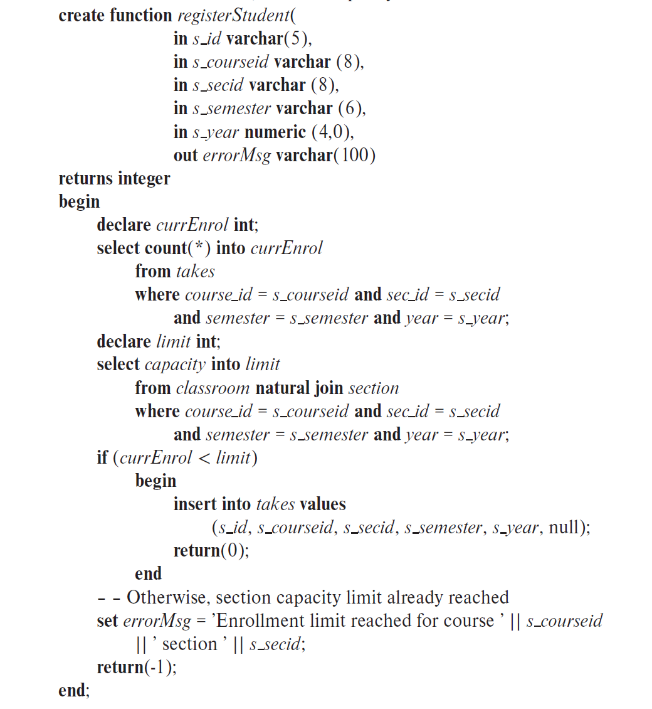
Example procedure

Slide 41
External Language Functions/Procedures
外部语言定义的函数和过程
SQL:1999 permits the use of functions and procedures written in other languages such as C or C++
Declaring external language procedures and functions
create procedure dept_count_proc(in dept_name varchar(20),
out count integer)
language C
external name ’ /usr/avi/bin/dept_count_proc’
create function dept_count(dept_name varchar(20))
returns integer
language C
external name ‘/usr/avi/bin/dept_count’
路径
但是这个会比较危险——一般把它放独立线程中隔离；java中的虚拟环境隔离

Slide 42
External Language Routines (Cont.)
Benefits of external language functions/procedures:
  more efficient for many operations, and more expressive power.
Drawbacks
  Code to implement function may need to be loaded into database system and executed in the database system’s address space.
    risk of accidental corruption of database structures
    security risk, allowing users access to unauthorized data
  There are alternatives, which give good security at the cost of potentially worse performance.
  Direct execution in the database system’s space is used when efficiency is more important than security.

Slide 43
Security with External Language Routines
To deal with security problems
  Use sandbox techniques
    that is use a safe language like Java, which cannot be used to access/damage other parts of the database code.
  Or, run external language functions/procedures in a separate process, with no access to the database process’ memory.
    Parameters and results communicated via inter-process communication
Both have performance overheads
Many database systems support both above approaches as well as direct executing in database system address space.

Slide 44

以下不需要掌握

Slide 45
Triggers
A trigger is a statement that is executed automatically by the system as a side effect of a modification to the database.
  Trigger - ECA rule
  E: Event （ insert, delete ，update）
  C: Condition
  A: Action
To design a trigger mechanism, we must:
  Specify the conditions under which the trigger is to be executed.
  Specify the actions to be taken when the trigger executes.
Triggers introduced to SQL standard in SQL:1999, but supported even earlier using non-standard syntax by most databases.

Slide 46
Trigger Example
account_log(account, amount, datetime)
create trigger account_trigger after update of account on balance
referencing new row as nrow
referencing old row as orow
for each row
when nrow.balance - orow.balance > =200000 or
orow.balance -nrow.balance >=50000
begin
insert into account_log values (nrow.account-number,
nrow.balance-orow.balance , current_time() )
end

Slide 47
Trigger Example
检查foreign key
E.g. time_slot_id is not a primary key of timeslot, so we cannot create a foreign key constraint from section to timeslot.
Alternative: use triggers on section and timeslot to enforce integrity constraints
create trigger timeslot_check1 after insert on section
referencing new row as nrow
for each row
when (nrow.time_slot_id not in (
select time_slot_id
from time_slot)) /* time_slot_id not present in time_slot */
begin
rollback
end;

Slide 48
Trigger Example Cont.
create trigger timeslot_check2 after delete on timeslot
referencing old row as orow
for each row
when (orow.time_slot_id not in (
select time_slot_id
from time_slot)
/* last tuple for time slot id deleted from time slot */
and orow.time_slot_id in (
select time_slot_id
from section))
/* and time_slot_id still referenced from section*/
begin
rollback
end;

Slide 49
Triggering Events and Actions in SQL
Triggering event can be insert, delete or update
Triggers on update can be restricted to specific attributes
  E.g., after update of takes on grade
Values of attributes before and after an update can be referenced
  referencing old row as : for deletes and updates
  referencing new row as : for inserts and updates
Triggers can be activated before an event, which can serve as extra constraints. E.g. convert blank grades to null.
create trigger setnull_trigger before update of takes
referencing new row as nrow
for each row
when (nrow.grade = ‘ ‘)
begin atomic
set nrow.grade = null;
end;

Slide 50
Trigger to Maintain credits_earned value
create trigger credits_earned after update of takes on grade
referencing new row as nrow
referencing old row as orow
for each row
when nrow.grade <> ’F’ and nrow.grade is not null
and (orow.grade = ’F’ or orow.grade is null)
begin atomic
update student
set tot_cred= tot_cred +
(select credits
from course
where course.course_id= nrow.course_id)
where student.id = nrow.id;
end;
没必要，precedure更好（慎用触发器，触发隐含动作，触发逻辑不是很明确）
保证学分不重复记

Slide 51
Statement Level Triggers
Instead of executing a separate action for each affected row, a single action can be executed for all rows affected by a transaction
  Use for each statement instead of for each row
  Use referencing old table or referencing new table to refer to temporary tables (called transition tables) containing the affected rows
  Can be more efficient when dealing with SQL statements that update a large number of rows

Slide 52
Statement Level Triggers
create trigger grade_trigger after update of takes on grade
referencing new table as new_table
for each statement
when exists( select avg(grade)
from new_table
group by course_id, sec_id, semester, year
having avg(grade)< 60 )
begin
rollback
end
这里不是使用Each row，而且each statement要用原表和新表 table

Slide 53
When Not To Use Triggers
Triggers were used earlier for tasks such as
  maintaining summary data (e.g., total salary of each department)
  Replicating databases by recording changes to special relations (called change or delta relations) and having a separate process that applies the changes over to a replica
There are better ways of doing these now:
  Databases today provide built in materialized view facilities to maintain summary data
  Databases provide built-in support for replication
Encapsulation facilities can be used instead of triggers in many cases
  Define methods to update fields
  Carry out actions as part of the update methods instead of
  through a trigger

Slide 54
When Not To Use Triggers
Risk of unintended execution of triggers, for example, when
  loading data from a backup copy
  replicating updates at a remote site
  Trigger execution can be disabled before such actions.
Other risks with triggers:
  Error leading to failure of critical transactions that set off the trigger
  Cascading execution

Slide 55

SQL and Relational Algebra(这里的最后两页是从ch2拷贝过来的，不知道这样的相互转换要不要掌握）
select A1, A2, .. An
from r1, r2, …, rm
where P
is equivalent to the following expression in multiset relational algebra
∏ _{A1, .., An} (σ _{P} (r1 x r2 x .. x rm) )
select A1, A2, sum(A3)
from r1, r2, …, rm
where P
group by A1, A2
is equivalent to the following expression in multiset relational algebra
_{A1, A2} _{sum(A3)} (σ _{P} (r1 x r2 x .. x rm)))

Slide 56
SQL and Relational Algebra
More generally, the non-aggregated attributes in the select clause may be a subset of the group by attributes, in which case the equivalence is as follows:
select A1, sum(A3)
from r1, r2, …, rm
where P
group by A1, A2
is equivalent to the following expression in multiset relational algebra
∏ _{A1,sumA3}( _{A1,A2} _{sum(A3)} _{as sumA3}(σ _{P} (r1 x r2 x .. x rm)))

